Slide 1

Cloud Native DevSecOps on IBM LinuxONE with OpenShift
Barry Silliman
Blockchain Enablement
IBM Washington Systems Center
Garrett Woodworth
Technical Enablement Specialist
IBM Washington Systems Center
Presented by the Washington Systems Center

Slide 2
Roadmap
1
DevSecOps on LinuxONE
2
DevSecOps in Practice: PetClinic

Slide 3
DevSecOps on IBM LinuxONE

Slide 4
What Each Team Wants
Development
Operations
Security
Meet Project Roadmap Timelines
Stability of IT deployments
Secure Code
Meet User Requirements
Prevent Vulnerabilities
Protect Data
Deliver Software Quickly
Limit code problems in production (risk management)
Quality Code
Limit areas of exposure

Slide 5
Bringing Everyone Together to Solve Problems
Requires:
1. Defining each step of the code lifecycle
2. Assigning criteria (measurable objectives) to each step
3. Creating tests to verify that each criteria is met before proceeding
4. Automating process based on these tests => Continuous Integration / Continuous Deployment (CI/CD) Pipeline

Slide 6
Defining DevSecOps
1. portmanteau of development, security, and operations
2. Signifies fusion of these 3 formerly disparate IT teams under 1 methodology
3. Uses automation (CI/CD) systems to seamlessly transition code across stages (development, Quality Assurance (QA), staging, production) in a multitude of environments
4. Automated Unit and Integration Testing
5. Automated Vulnerability Scanning of static and active code
6. ⬆️ delivery speed + ⬇️ problem identification time => ⬆️ efficiency + ⬆️ security

Slide 7
Steps
Code
Build
Provision + Deploy
Test
Analyze
Plan
Monitor
Release

Slide 8
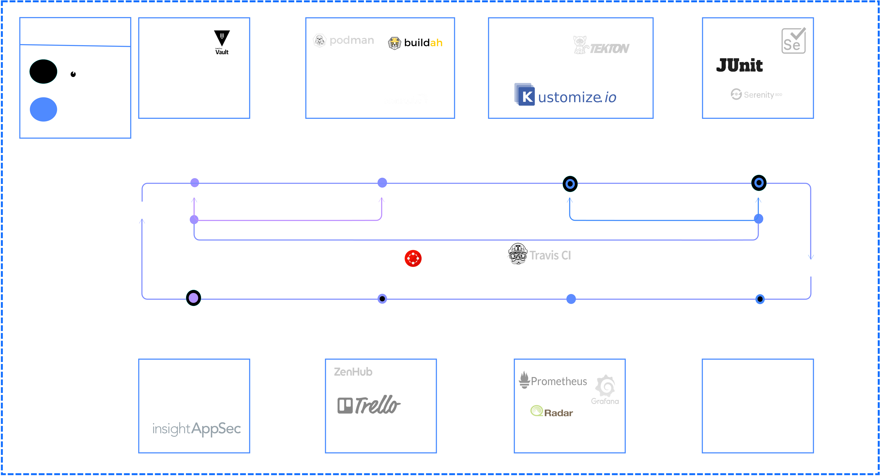

Slide 9


When are the best times to use IBM zSystems / LinuxONE?
Data Gravity
Consolidation and TCO Reduction
Modernize Existing Applications
Blockchain and Digital Assets Management
Specific languages such as Java
9

Slide 10
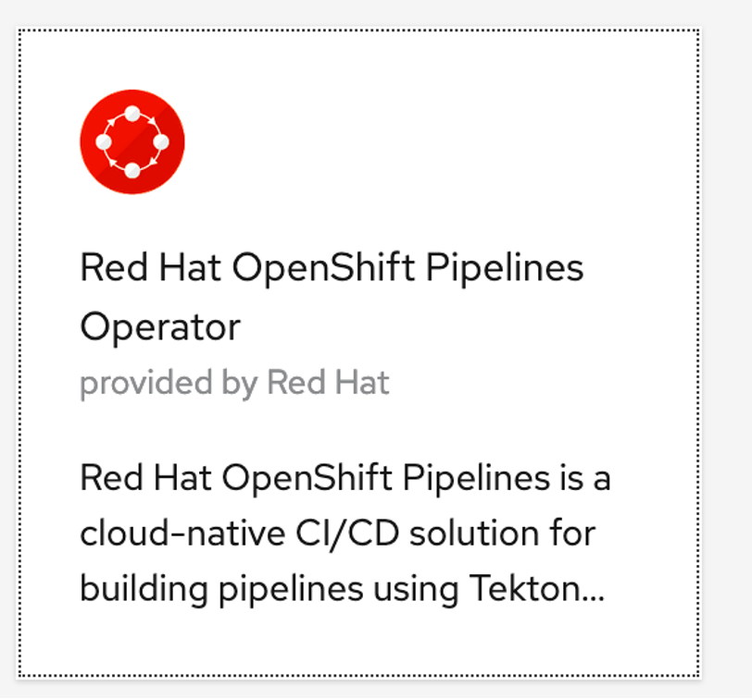
OpenShift Pipelines Operator

Slide 11

OpenShift Pipelines
Kubernetes native resources in yaml
Serverless with no central server
integrates with OpenShift via easy operator install
Red Hat supports the platform with constant improvements and patches
Red Hat provides 310+ s390x images for users that they scan for security vulnerabilities and provide patches
Red Hat leverages their images to make cluster tasks that use multi-architecture images and run seamlessly on multiple architectures such as s390x (IBM zSystems and LinuxONE) and amd64 (x86)
OpenShift’s interactive pipeline UI gets users up and running quickly

Slide 12

Java on IBM LinuxONE (s390x)?
Java JVM hw + os detection => optimize existing java code for newest IBM zSystems / LinuxONE hw without application code changes (just need to upgrade JVM and underlying stack)
Optimizations for s390x include SIMD, pause-less garbage collection, and on-chip compression
OpenJ9 is a container-aware JVM supported by AdoptOpenJDK and IBM SDK Java Tech Edition, Version 8 and 11 => faster, smaller, more efficient java microservices

Slide 13
Applying to PetClinic Application

Slide 14
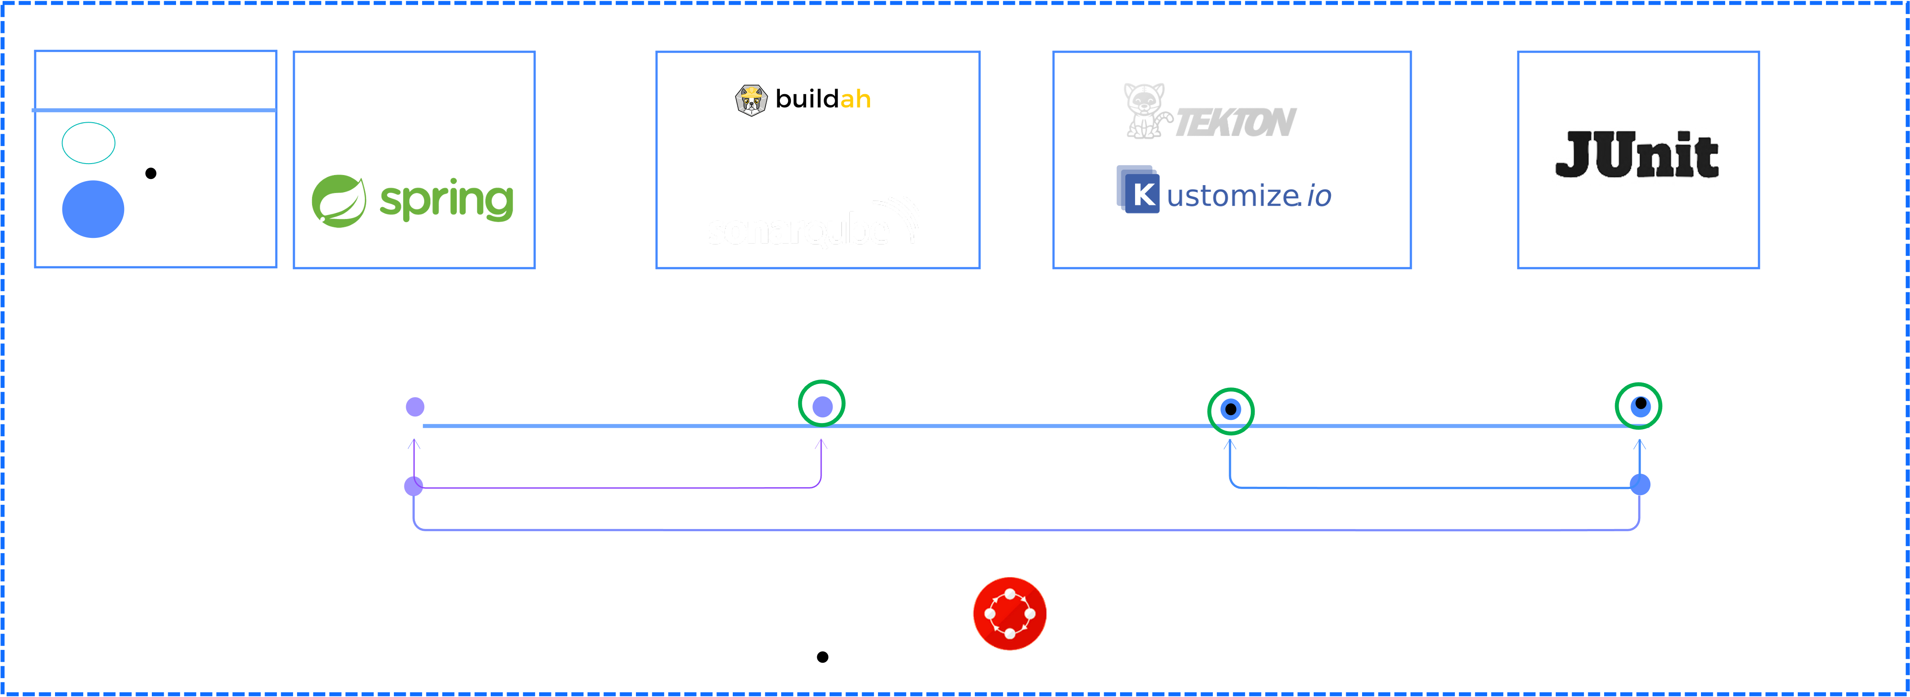
PetClinic DevSecOps Pipeline

Slide 15
Helpful Links
Code Pattern:
https://www.ibm.com/community/z/linuxone-cc/faststart/
Code Pattern Resources
https://github.com/ibm-wsc/spring-petclinic
https://github.com/tektoncd/cli
https://linuxone.cloud.marist.edu/#/register?flag=OCP
OpenShift Pipelines:
https://docs.openshift.com/container-platform/4.11/cicd/pipelines/understanding-openshift-pipelines.html
https://www.openshift.com/learn/topics/pipelines
https://www.openshift.com/blog/guide-to-openshift-pipelines-part-1-introducing-openshift-pipelines
OpenShift Multi-architecture Java Images
https://docs.openshift.com/online/pro/using_images/s2i_images/java.html
https://catalog.redhat.com/software/containers/open-liberty-s2i/5d7bf0add095e36f9d387b17
https://catalog.redhat.com/software/containers/search?q=openj9%2F&p=1

Slide 16
Notices and disclaimers
Performance data contained herein was generally obtained in a controlled, isolated environments. Customer examples are presented as illustrations of how those
customers have used IBM products and the results they may have achieved. Actual performance, cost, savings or other results in other operating environments may vary.
References in this document to IBM products, programs, or services does not imply that IBM intends to make such products, programs or services available in all countries in which IBM operates or does business.
Workshops, sessions and associated materials may have been prepared by independent session speakers, and do not necessarily reflect the views of IBM. All materials and discussions are provided for informational purposes only, and are neither intended to, nor shall constitute legal or other guidance or advice to any individual participant or their specific situation.
It is the customer’s responsibility to insure its own compliance with legal requirements and to obtain advice of competent legal counsel as to the identification and interpretation of any relevant laws and regulatory requirements that may affect the customer’s business and any actions the customer may need to take to comply with such laws. IBM does not provide legal advice or represent or warrant that its services or products will ensure that the customer follows any law.
© 2022 International Business Machines Corporation. No part of this document may be reproduced or transmitted in any form without written permission from IBM.
U.S. Government Users Restricted Rights — use, duplication or disclosure restricted by GSA ADP Schedule Contract with IBM.
Information in these presentations (including information relating to products that have not yet been announced by IBM) has been reviewed for accuracy as of the date of initial publication and could include unintentional technical or typographical errors. IBM shall have no responsibility to update this information. This document is distributed “as is” without any warranty, either express or implied. In no event, shall IBM be liable for any damage arising from the use of this information, including but not limited to, loss of data, business interruption, loss of profit or loss of opportunity. IBM products and services are warranted per the terms and conditions of the agreements under which they are provided.
IBM products are manufactured from new parts or new and used parts. In some cases, a product may not be new and may have been previously installed. Regardless, our warranty terms apply.”
Any statements regarding IBM's future direction, intent or product plans are subject to change or withdrawal without notice.
IBM Systems Technical University © Copyright IBM Corporation 2020
16

Slide 17
Notices and disclaimers
Information concerning non-IBM products was obtained from the suppliers of those products, their published announcements or other publicly available sources. IBM has not tested those products about this publication and cannot confirm the accuracy of performance, compatibility or any other claims related to non-IBM products. Questions on the capabilities of non-IBM products should be addressed to the suppliers of those products. IBM does not warrant the quality of any third-party products, or the ability of any such third-party products to interoperate with IBM’s products. IBM expressly disclaims all warranties, expressed or implied, including but not limited to, the implied warranties of merchantability and fitness for a purpose.
The provision of the information contained herein is not intended to, and does not, grant any right or license under any IBM patents, copyrights, trademarks or other intellectual property right.
IBM, the IBM logo, ibm.com and [names of other referenced IBM products and services used in the presentation] are trademarks of International Business Machines Corporation, registered in many jurisdictions worldwide. Other product and service names might be trademarks of IBM or other companies. A current list of IBM trademarks is available on the Web at "Copyright and trademark information" at: www.ibm.com/legal/copytrade.shtml
IBM Systems Technical University © Copyright IBM Corporation 2020
17

Slide 18

© 2022 International Business Machines Corporation

